Slide 1
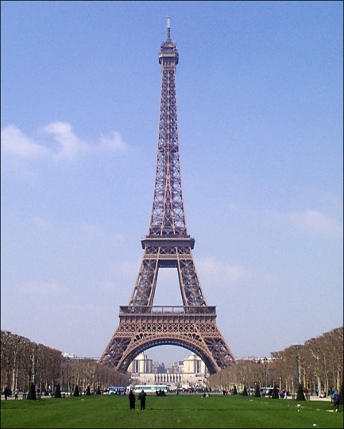
Katoomba High School
French Studies

Slide 2
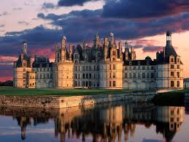
Aim of course and Assessment Guidelines
The aim of studying French is to enable students to develop skills in effective communication, knowledge of the nature of language and an understanding of the interdependence of language and culture.
Assessment will include conversation and speaking tasks, written expression in French, reading comprehension and listening skills.

Slide 3
Examples of Tasks
We learn how language works through many fun activities such as:
making films
writing and acting in plays
conducting interviews
creating role-plays
creating blogs
using Web 2.0 tools such as Prezi, Animoto and Glogster
listening and responding to advertisements, announcements, messages, conversations, news items, emails
reading extracts from magazines
watching films and TV shows in French
producing different kinds of writing such as articles, diary entries, letters, postcards
We learn how language works through many fun activities such as:
making films
writing and acting in plays
conducting interviews
creating role-plays
creating blogs
using Web 2.0 tools such as Prezi, Animoto and Glogster
listening and responding to advertisements, announcements, messages, conversations, news items and emails
reading extracts from magazines
watching films and TV shows in French
producing different kinds of writing such as articles, diary entries, letters and postcards

Slide 4
Expectations and Content
Students can study French in Stages 4, 5 and 6. The Stage 6 French Beginners course is a two-year course which has been designed for students who wish to begin their study of French at senior secondary level. It is intended to cater only for students with no prior knowledge or experience of the French language, or whose experience is equivalent to the study of the French language for 100 hours or less in Stage 4 or Stage 5. The Stage 6 French Continuers course is for students who have studied French for more than 100 hours. The course allows students to further develop their knowledge and skills across a range of texts and text types.
The Preliminary course covers topics which provide contexts in which students develop their communication skills in French and their knowledge and understanding of language and culture.
In the HSC course, students will extend and refine their communication skills in French and will gain a deeper knowledge and understanding of language and culture.
The prescribed topics will be studied from the two interdependent perspectives of the personal world and the French-speaking communities. Topics include: family life, home and neighbourhood; people, places and communities; education and work; friends, recreation and pastimes; holidays, travel and tourism; and future plans and aspirations.

Slide 5
Why choose French at Katoomba High School?
Not only is learning French fun, but French is by far one of the most beautiful, poetic and inspiring languages of all the romance languages of Europe.
Learning a language opens up a whole world of cultural experiences and is a valuable part of our students’ education.
Learning a new language allows us to celebrate difference and diversity and it is a wonderful opportunity to help us to understand how people from other cultures interact with the world.
In French, we not only have fun learning a new language, we also enjoy learning about the culture, religion, history, dress, music, food and cooking of France and other francophone countries such as Switzerland, Belgium, Canada, many African nations and our neighbours in the Pacific.
The French language is spoken in more than 40 countries, including some of Australia’s nearest neighbours and it is one of the most widely spoken and taught European languages in the world. French is one of the most common second languages in Australia.
Learning another language helps us to understand how language works, and many students develop a more sophisticated understanding of the English language which helps to improve overall literacy skills.
The study of French provides students with knowledge, understanding and skills that form a valuable foundation for a range of courses at university and other tertiary institutions. There are opportunities for future employment and experience in areas such as education, public relations, commerce, hospitality, marketing, international relations, media and tourism.
Don’t miss out on studying French at Katoomba High School!
Contact Ms Gibson today at brigid.gibson@det.nsw.edu.au

